Slide 1
Updates 23 Nov 2021
https://github.com/zoyafuso-NOAA/Arctic_GF_OM

Slide 2
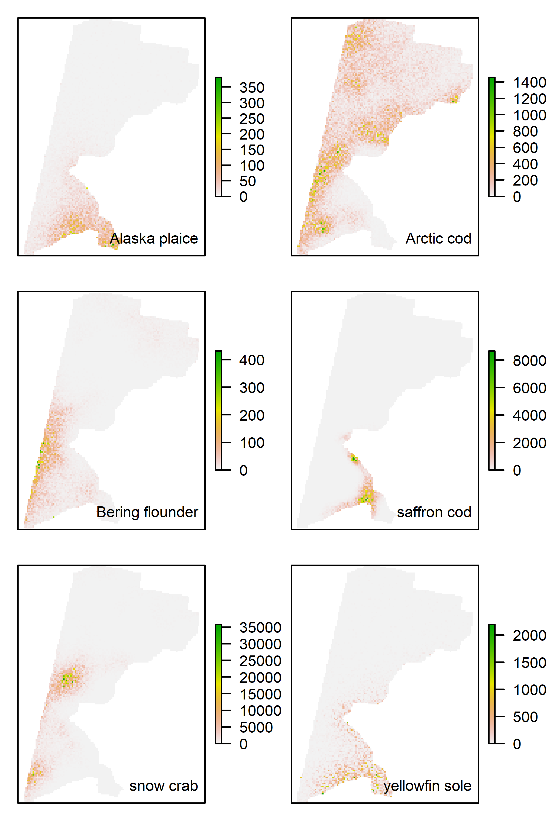

Slide 3
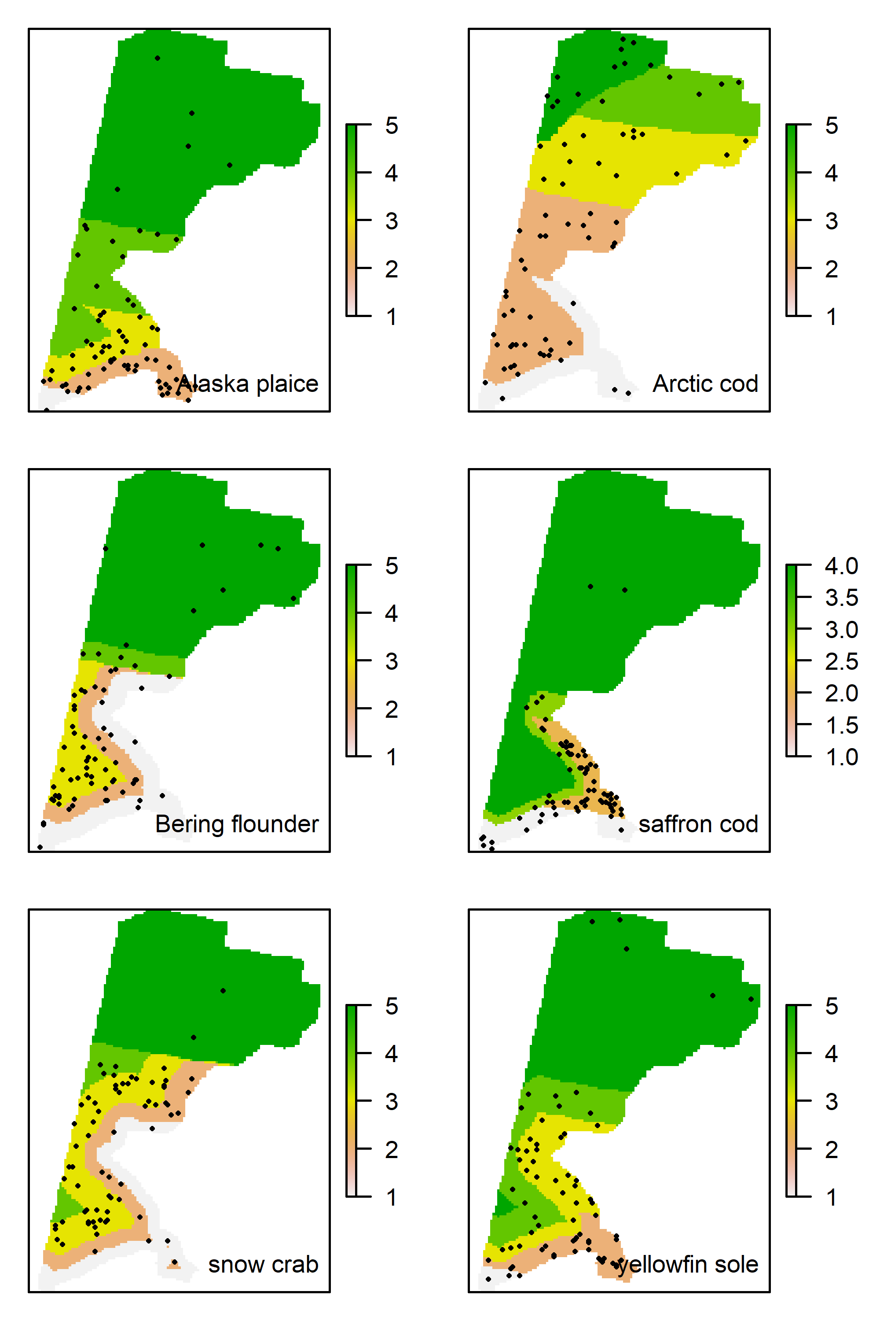
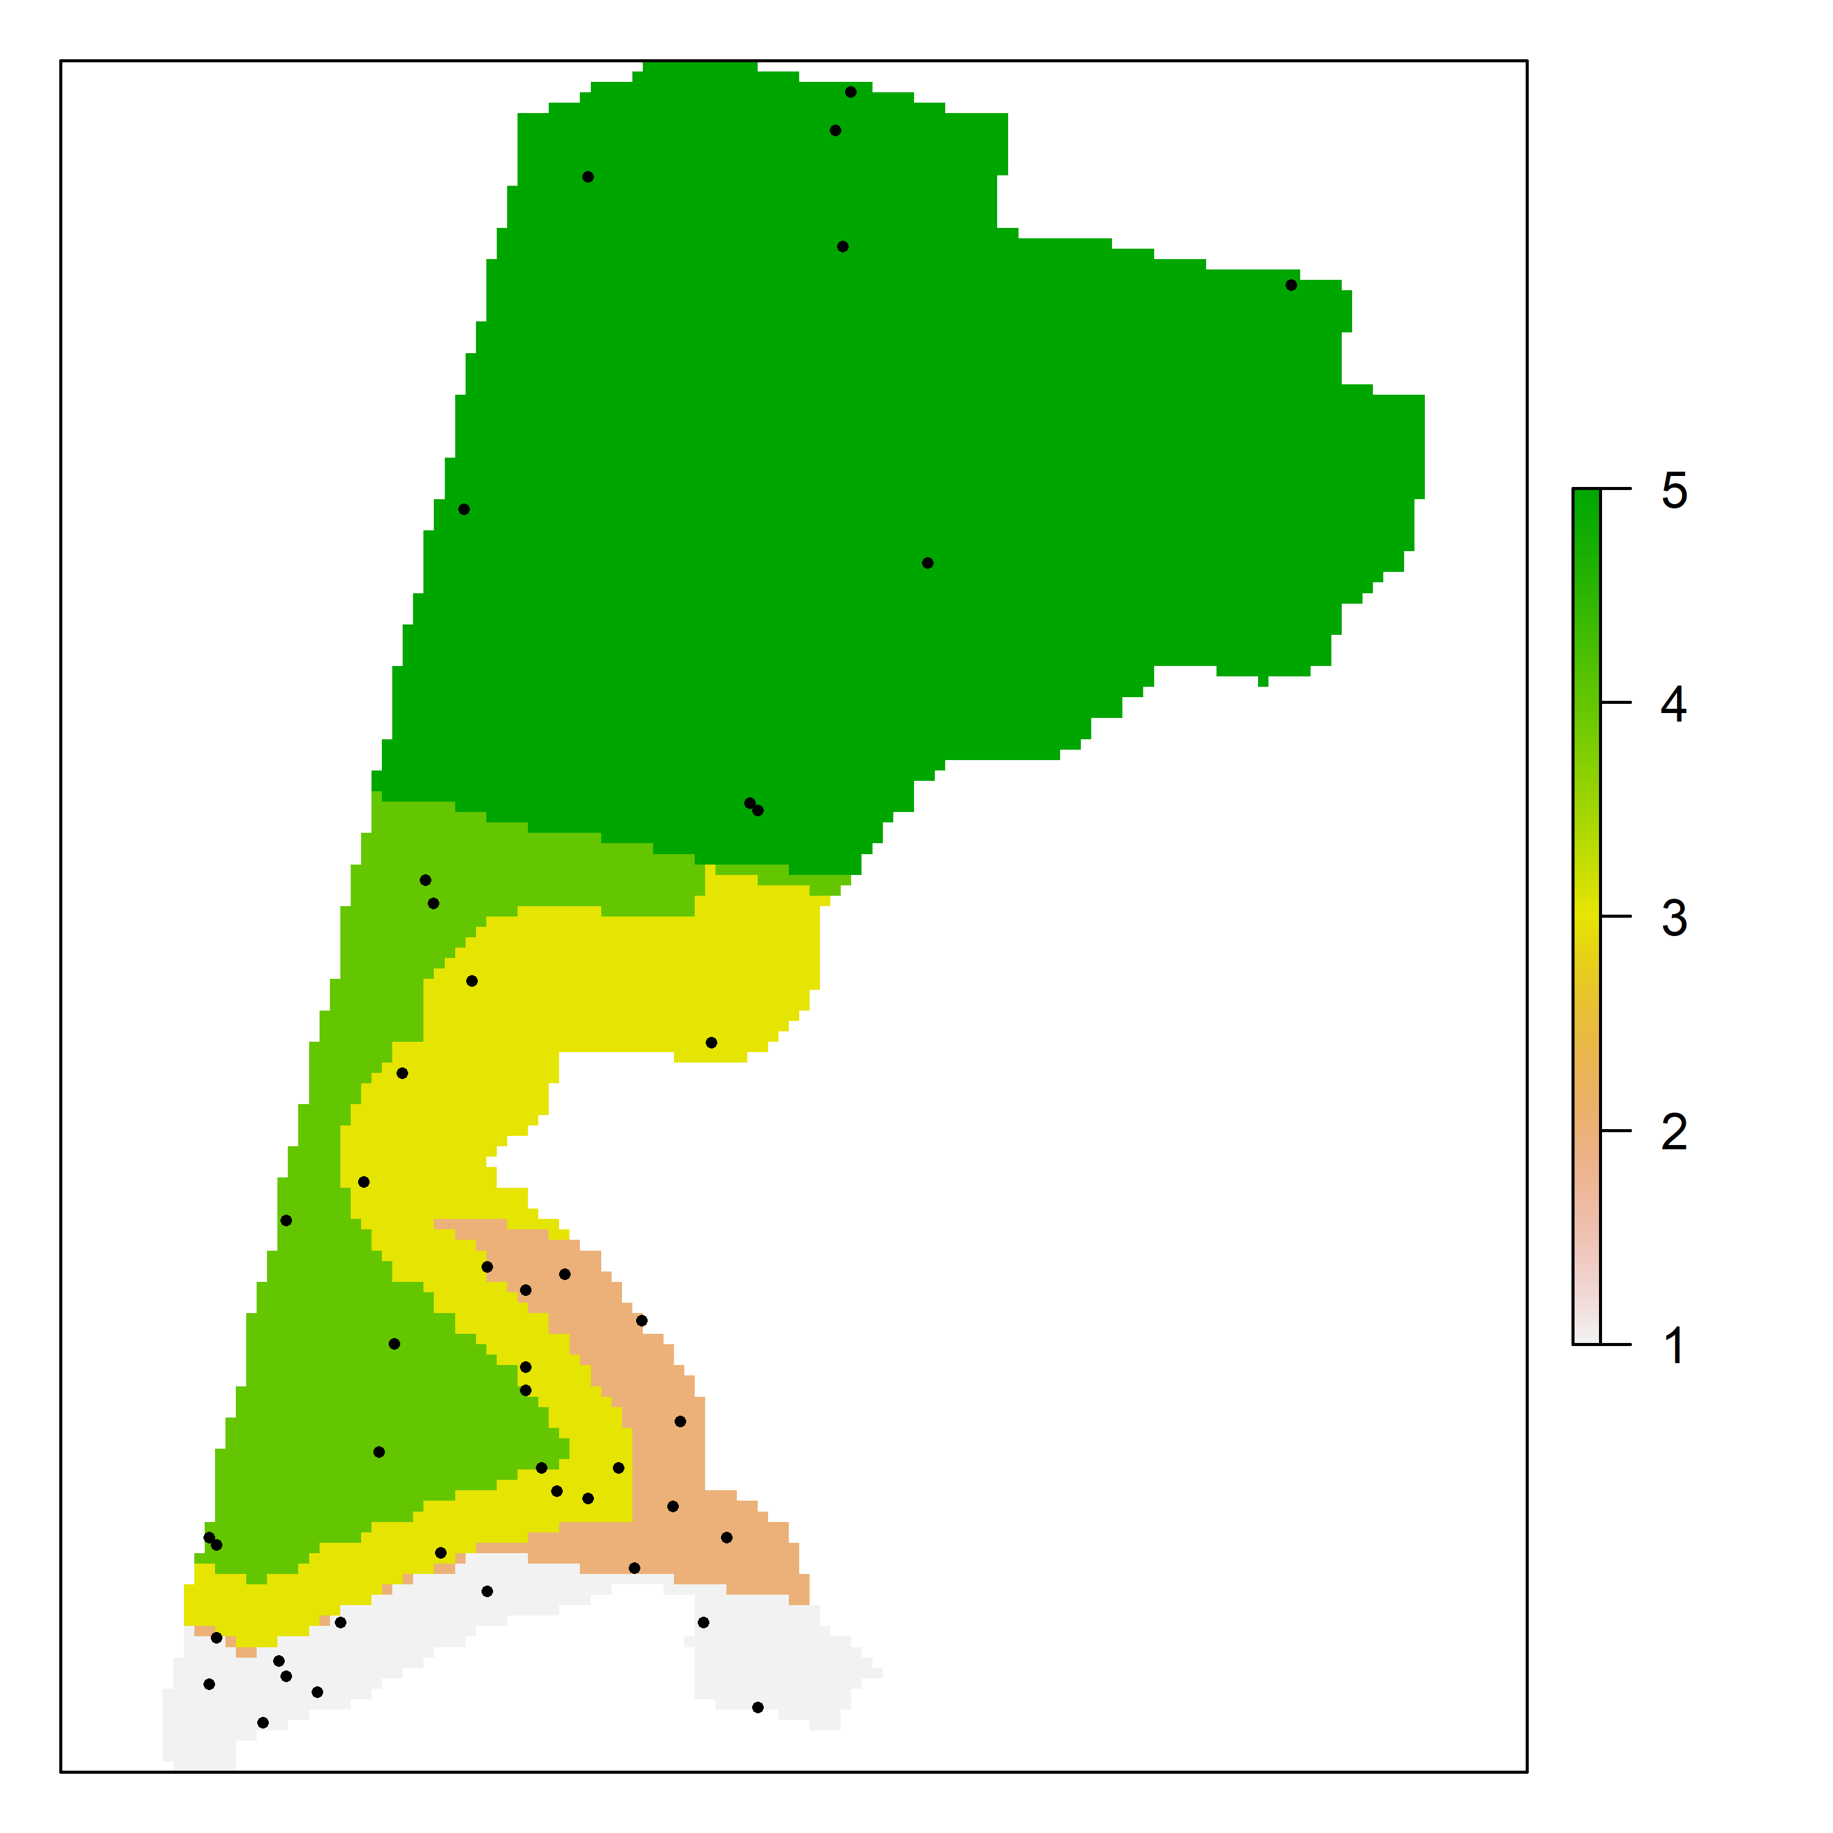

Slide 4
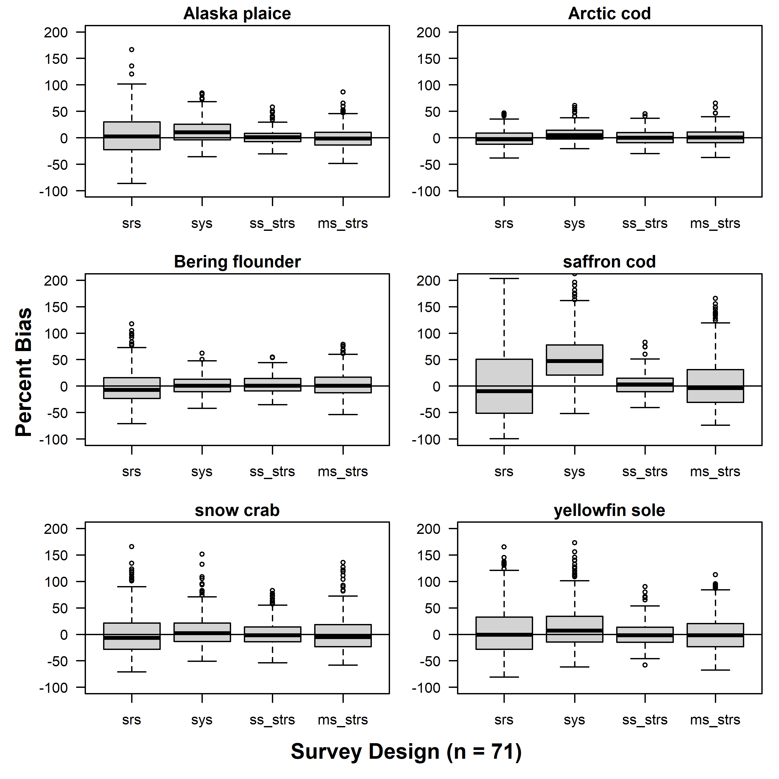
Percent Bias

Slide 5
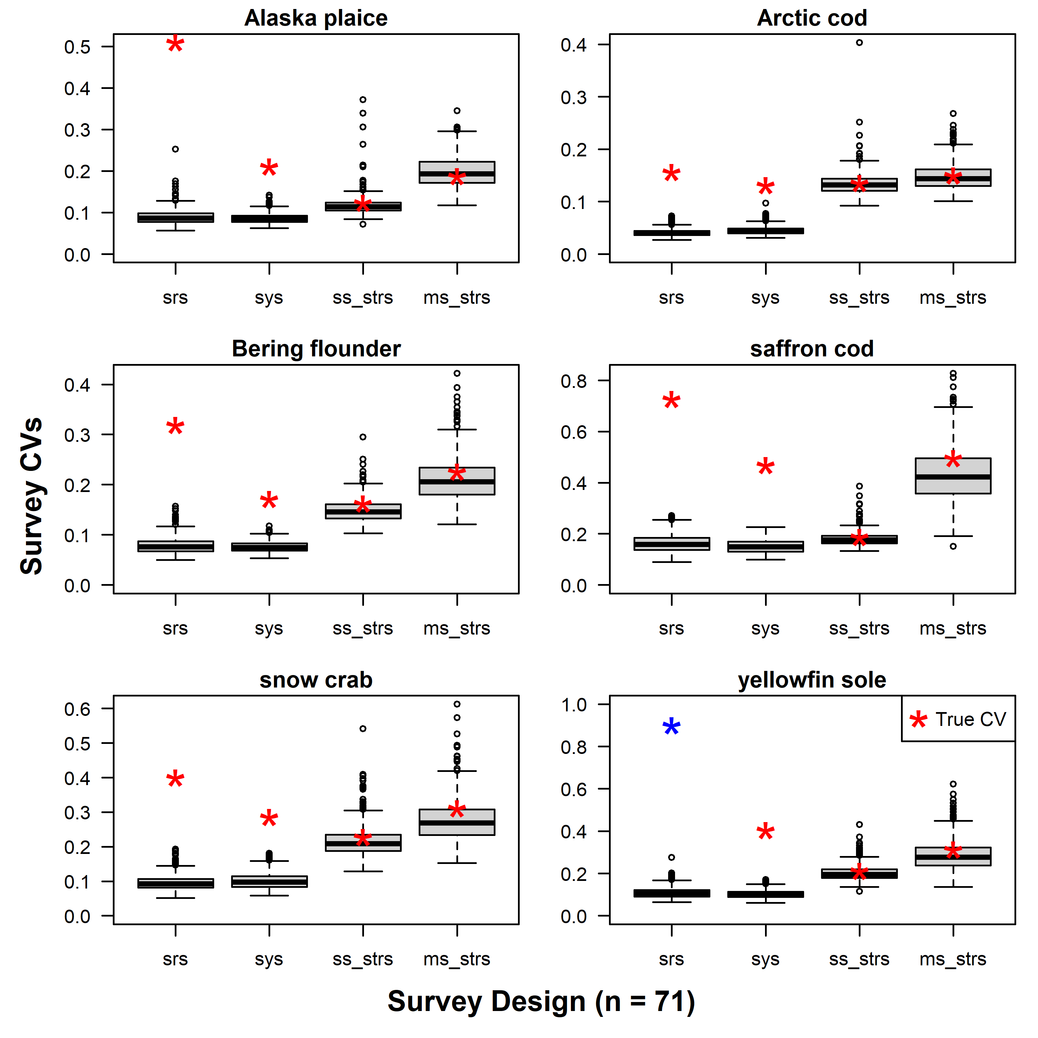
Survey CVs

Slide 6
RRMSE of CV
RRMSE | srs | sys | ss_strs | ms_strs
Alaska plaice | 4.70 | 1.47 | 0.21 | 0.20
Arctic cod | 2.81 | 1.91 | 0.17 | 0.17
Bering flounder | 3.05 | 1.25 | 0.18 | 0.22
saffron cod | 3.44 | 2.10 | 0.15 | 0.29
snow crab | 3.15 | 1.84 | 0.21 | 0.25
yellowfin sole | 29.60 | 2.93 | 0.18 | 0.26

